Slide 1
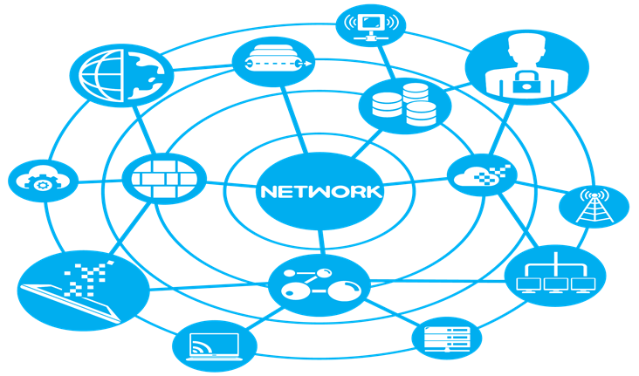

Viscous: An End-to-End Protocol for Ubiquitous Communication over Internet of Everything
Complex Networks Research Group (CNeRG) Department of Computer Science and Engineering
INDIAN INSTITUTE OF TECHNOLOGY
KHARAGPUR
Authors: Abhijit Mondal
Sandip Chakraborty

Slide 2
What is Viscous?

Slide 3

The Viscous Transport Protocol
Multipath, multiplexed, mobile and low-latency transport protocol
Designed on top of UDP
Provides a wrapper between the user application and TCP/IP stack to support
Multi-homing
Mobility
Short lived flows

Slide 4
Why do we need Viscous?

Slide 5
The Internet

Slide 6
The Internet

Slide 7

The Internet

Slide 8
The Internet

Slide 9
The Internet

Slide 10
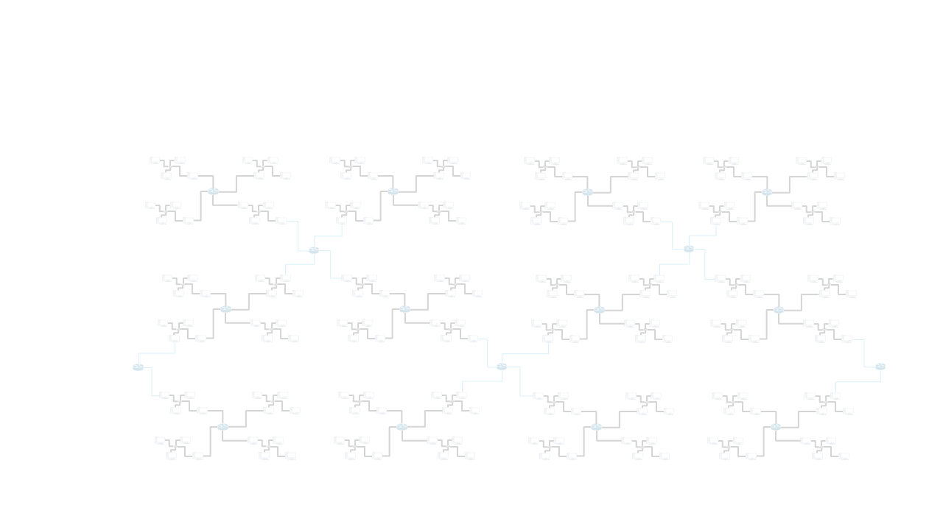
The Internet
Connect devices around the globe
TCP/IP protocol stack designed in 70’s
Provides connectivity between devices
Provides end-to-end reliable data communication between devices
As Internet grows over the time, it become more difficult to handle
The Internet

Slide 11
The Internet: TCP/IP Protocol Stack
Application
Transport
TCP
UDP
Network
IP
Data-Link
MAC
TCP/IP Stack

Slide 12
Limitations of TCP/IP Stack
Lack of Mobility
TCP does not support seamless connectivity during mobility
Lack of Multihoming
Devices connected to the Internet via multiple interfaces are multihomed devices
TCP can not use multiple paths offered by multihomed devices
No support for Short-lived Flows
Web-browsing, device-to-device communications between devices are mostly short-lived. However number of short-lived flows are huge.
TCP performs poorly while communicating using short-lived connections

Slide 13
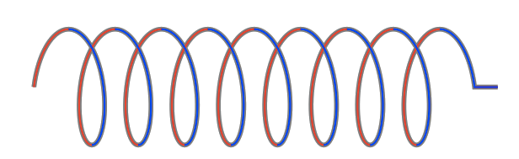
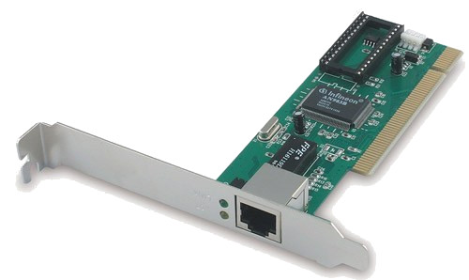
Mobility and Multipath
Application 1
Application 2
Basic requirement of a connection
Connection Identifier
Required by connection handler (mainly OS)
TCP uses four tuple of <SRC IP, SRC PORT, DST IP, DST PORT>
Address
To deliver packet to correct destination
TCP uses <IP:PORT>
Transport
TCP
UDP
TCP
UDP
Network
IP
IP
Data-Link
MAC
MAC
TCP/IP Stack

Slide 14
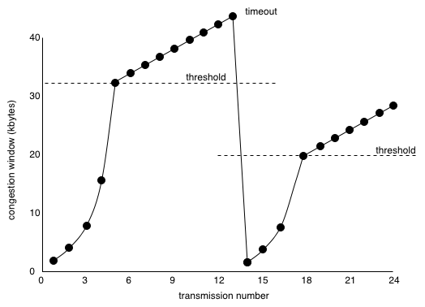
Problem with Short-lived Flow: Issue with Slow-start Phase
RTT 1
RTT 2
RTT 3
RTT 4

Slide 15
Existing Solutions
Mobile IP¹, CM, SCTP², SST, TCP Fast Open³, MPTCP⁴, HTTP/2⁵, QUIC⁶ … and many more
¹ RFC4721, ² RFC4960, ³ RFC7413, ⁴ RFC6824, ⁵ RFC 7540, ⁶ Sigcomm, 2017

Slide 16
Problems with Existing Solutions
Middle-Box dominition
Firewall blocks new transport protocol
NAT box rewrite transport header
Slow deployment cycle
Deployment of improved TCP takes decades to roll out
Handshake delay
Each TCP connection need to go through 3-way handshaking. It cost 1 RTT.
Head-of-line Blocking delay
Single packet loss in HTTP2 blocks packets from all other stream (Latency tax)

Slide 17
What is new in Viscous?

Slide 18
The Viscous Solution
Application
Flow 1
Flow 2
Flow 3
Flow 4
Transport Headers
Transport Headers
Transport Headers
TCP
TCP
TCP
UDP
Transport
IP
IP
IP
Network
Data-link
MAC
MAC
MAC
Stack 1
Stack 2
Stack 3

Slide 19
The Viscous Solution
Application
Flow 1
Flow 2
Flow 3
Flow 4
Flow 1
Flow 2
Flow 3
Flow 4
Viscous
Transport Headers
Transport Headers
Transport Headers
Transport Headers
TCP
TCP
TCP
UDP
Transport
UDP
UDP
UDP
IP
IP
IP
IP
IP
IP
Network
Data-link
MAC
MAC
MAC
MAC
MAC
MAC
Stack 1
Stack 2
Stack 3
Stack 1
Stack 2
Stack 3

Slide 20
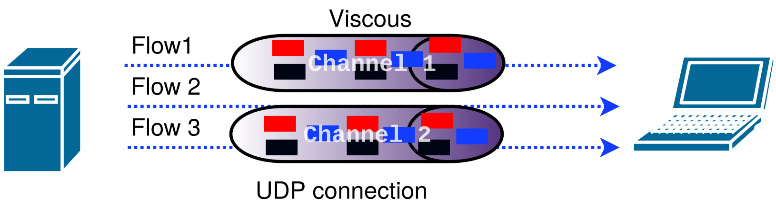
The Viscous Solution
Middle-Box dominition
On top of UDP as transport protocol
No new transport protocol
256-bit finger-print
Decoupled from network stack
Head-of-line Blocking delay
No sequential delivery constraint in UDP
Slow deployment cycle
Userspace implementation
Easy deployment and upgradation
Additional Features
Multipath
Flexible congestion control
Flow and congestion control separation
Handshake delay
0-RTT connection establishment
No-handshake delay
Notes:
Need to change

Slide 21
How does Viscous work?

Slide 22
Design of Viscous
Best of MPTCP and QUIC
0-RTT Connection establishment
Flow and channel separation
Flow control
Congestion control

Slide 23
Design of Viscous
MPTCP
SPDY/QUIC
Multi-Homing, Mobility
OSI Stack Flow Multiplexing 0-RTT connection establishment

Slide 24
Design of Viscous
MPTCP
SPDY/QUIC
Multi-Homing, Mobility
OSI Stack Flow Multiplexing 0-RTT connection establishment
UDP based
Reliability and Congestion Control at the presentation layer
Viscous

Slide 25
Viscous Design: 0-RTT Connection Establishment
Initial
Handshake
Client sends SYN request
Random NONCE
Server replies SYN-ACK
NONCE received in SYN request
Connection/Client finger-print
List of IP address and ports
Client sends ACK
with previously received finger-print
Client sends data packet
with previously received finger-print
Server sends ACK corresponding to data packet
Client
Server

Slide 26
Viscous Design: 0-RTT Connection Establishment
Initial
Handshake
Final Handshake
For subsequent flows, client simply start sending data packet with available finger-print
0-RTT connection establishment
Client
Server
Client
Server

Slide 27
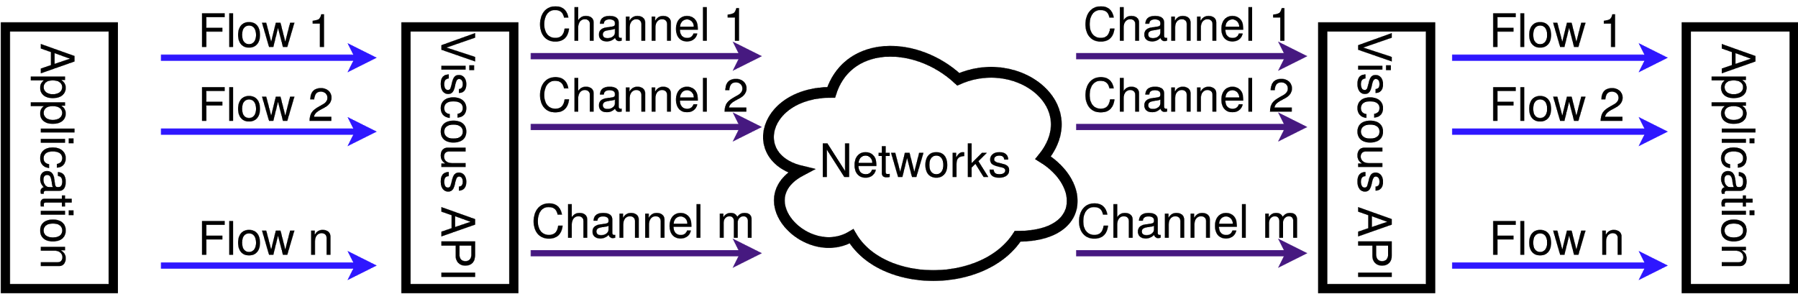
Design of Viscous
Decouples flows and channels
Connection Diagram

Slide 28
Design of Viscous
Decouples flows and channels
Flow Layer - Handles properties of the application flows

Slide 29
Design of Viscous
Decouples flows and channels
Channel Layer - Handles properties of reliable end-to-end paths

Slide 30
Design of Viscous
Decouples flow control and congestion control – congestion at one path should not affect traffic rate at other paths
Flow Control - at the Flow Layer

Slide 31
Design of Viscous
Decouples flow control and congestion control – congestion at one path should not affect traffic rate at other paths
Congestion Control - at the Channel Layer

Slide 32
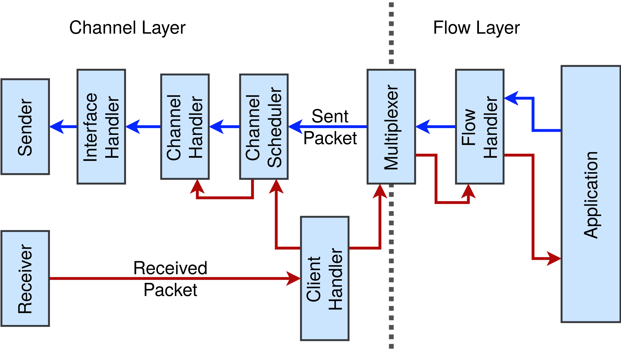
Design of Viscous
Modular architecture to support application programmability
Programmable
Easy to change behaviour
Flexible

Slide 33
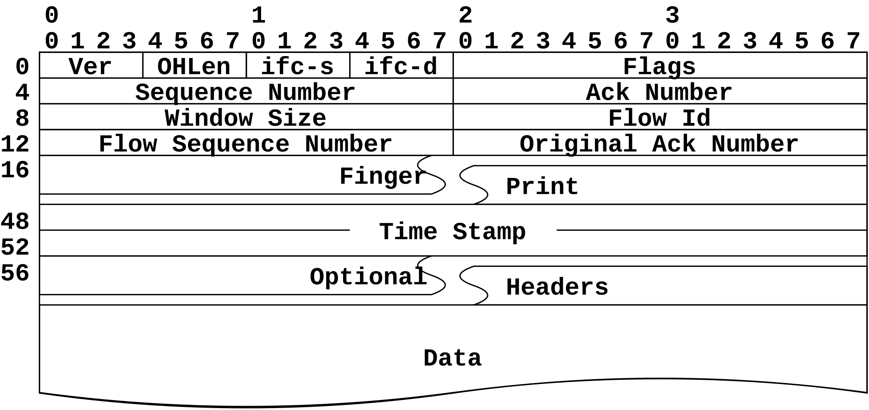
Design of Viscous
Modular architecture to support application programmability
Sliding Window based
Flow control

Slide 34
Design of Viscous
Modular architecture to support application programmability
ACK driven channel
scheduling

Slide 35
Design of Viscous
Modular architecture to support application programmability
ACK driven
Congestion Control

Slide 36
Viscous Design: Flow and Congestion Control
Congestion Control
It uses pluggable congestion control
For our implementation, we use NewReno with SACK based congestion control
Flow Control
Only flow layer handles flow-control
It periodically sends window update frames
Current implementation uses a feedback from flow layer to channel:
Overall throughput depends on both flow-control and congestion
Effective throughput is minimum of total throughput supported by flow layer and channel layer.

Slide 37
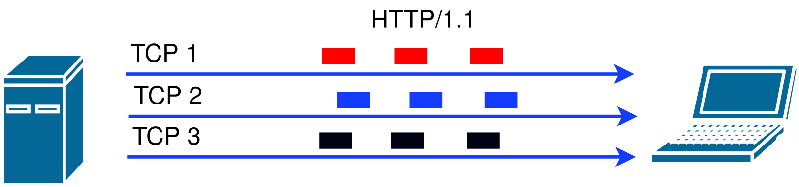
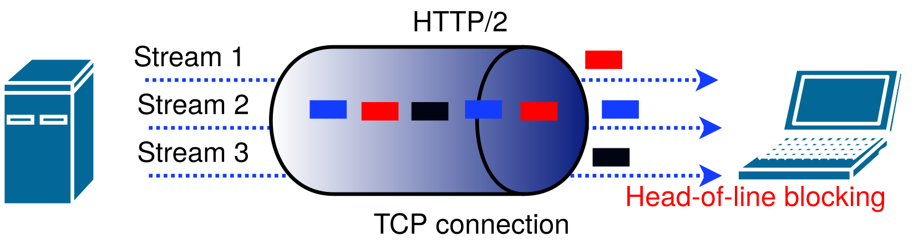
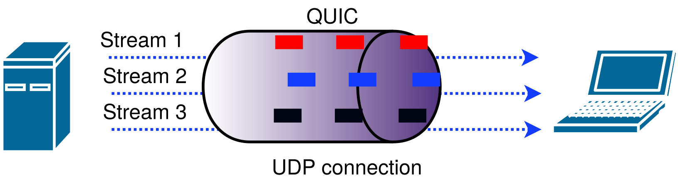
Viscous Design: Flow (Stream) Multiplexing
Flow identified using flow-id
16-bit integer
Server generates odd-Ids, client generates even-Ids
First byte (frame) with new stream id initiates a stream in remote side

Slide 38
Experimental Evaluation

Slide 39
Experimental Environment
Emulation:
System Configurations: Mininet inside VirtualBox
Mininet: version 2.2.2
Kernel: Linux-4.1.38-mptcp
MPTCP: v0.91
Operating System: Ubuntu 14.04.1
QUIC: libquic from github
We experimented in order to compare performance of our protocol with existing protocols MPTCP, TCP, and QUIC.
Real Setup:
Using Raspberry pi 3
Kernel: Linux-4.4.11+
Operating System: Raspbian GNU/Linux 8
We experimented support for mobility here

Slide 40
Experiment 1
Experimental Setup
Keep bandwidth and delay/RTT same for two path. (50 Mbps per path)
We change RTT all over the topology from 16ms to 320ms
For each RTT setup we sent flows through multiple parallel threads
Number of parallel threads to generates flows have been varied from 1 to 20
For each thread, we sent 100 back-to-back flows
We varied flow size based on an exponential distribution with mean flow size of 25Kb

Slide 41
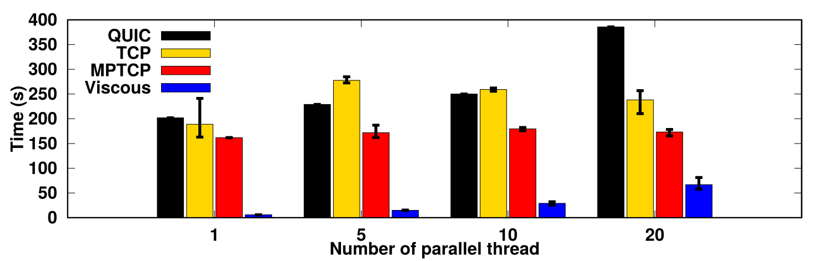
Experiment 1
Results: Time Required to Download
RTT=320ms
QUIC stalled due to coupled congestion control and flow control
TCP & MPTCP require reconnection
Viscous have no such problem

Slide 42
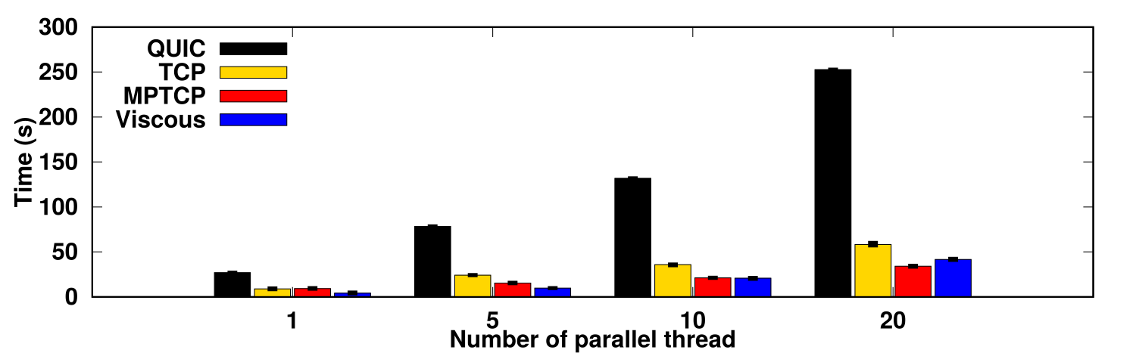
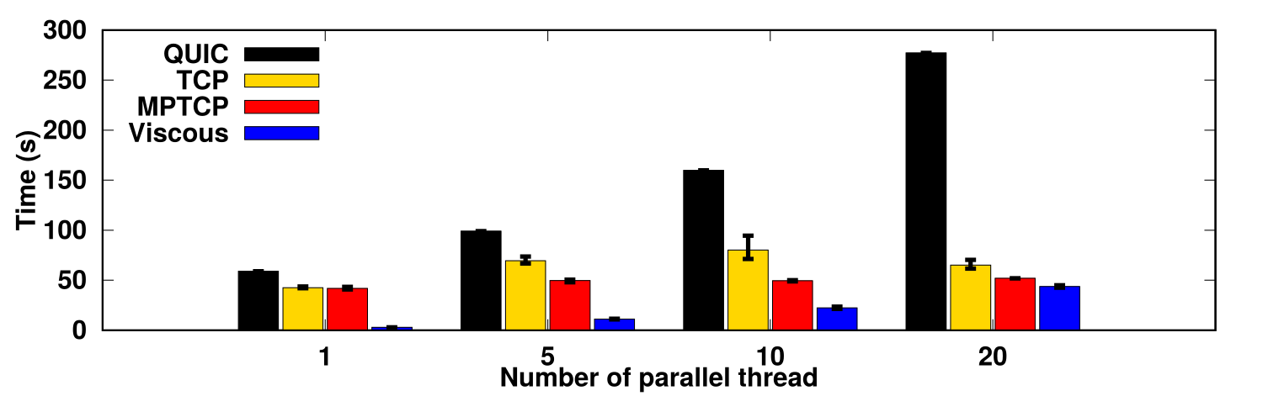
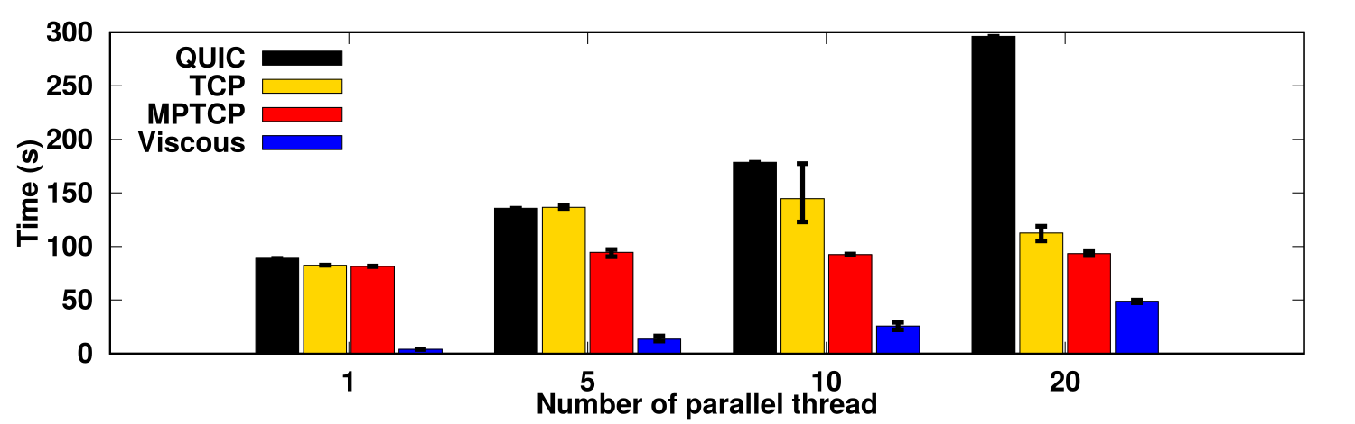
Experiment 1
Results: Time Required to Download
RTT=16ms
RTT=80ms
Similar results as before
RTT=160ms

Slide 43
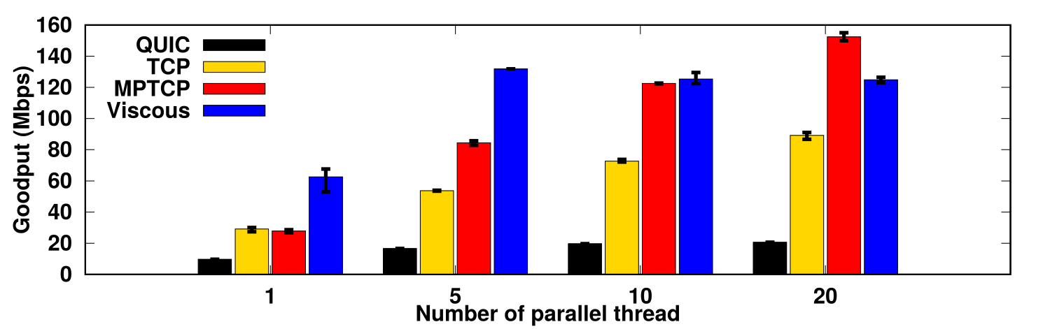
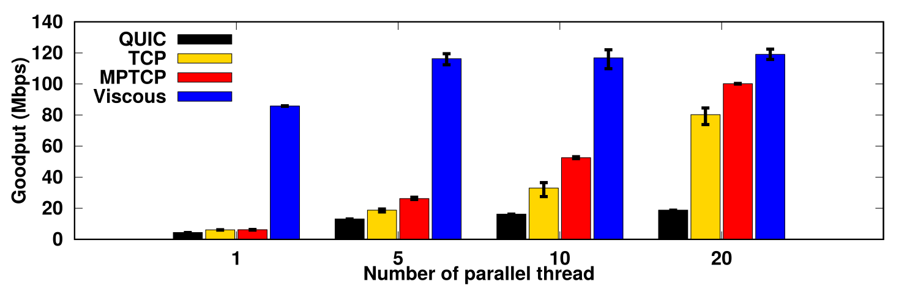
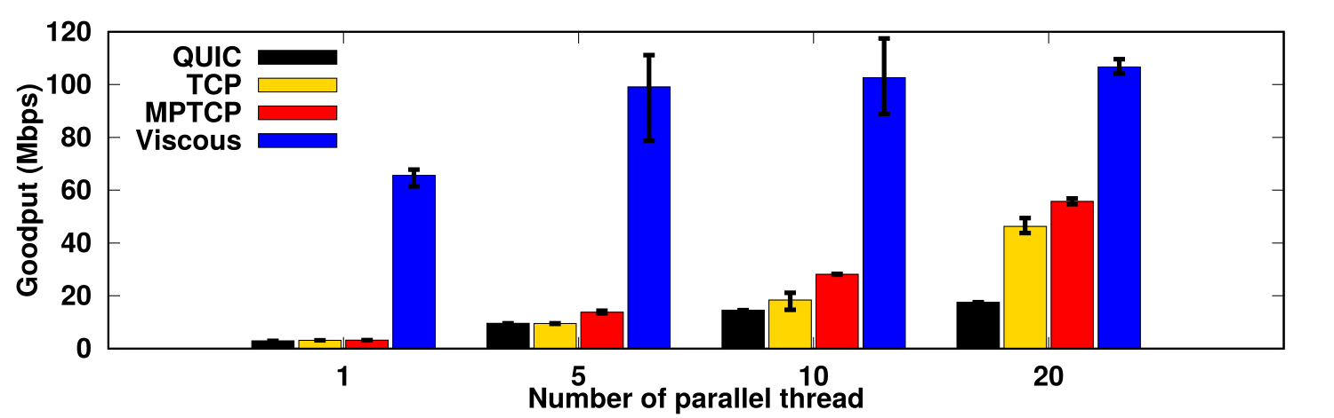
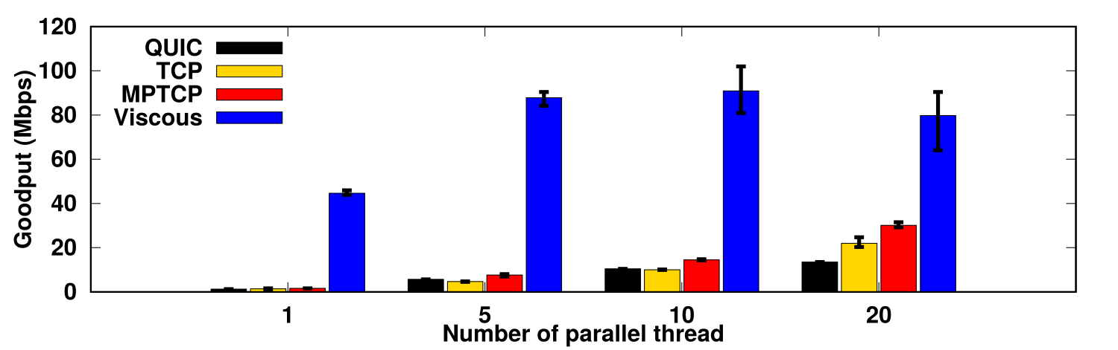
Experiment 1
Results: Goodput
RTT=16ms
RTT=80ms
RTT=160ms
RTT=320ms

Slide 44
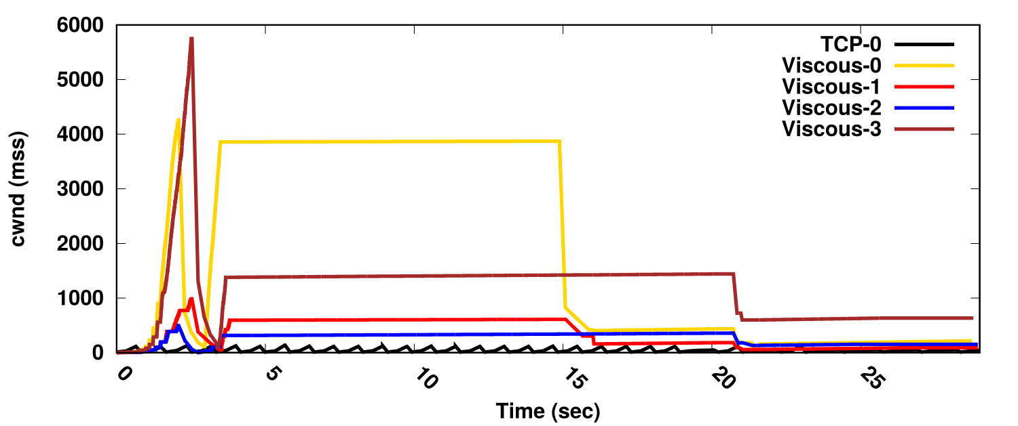
Experiment 1
Result: Congestion Window Size

Slide 45
Experiment 1
Result: Congestion Window Size
Large cwnd
Small cwnd

Slide 46
Experiment 2: experiment on long flow
Experimental Setup
We sent file from H2 to H1
We keep RTT to fixed to 160ms
File size has been varied from 100MB to 1000MB
Run this test only for TCP Cubic and Viscous

Slide 47
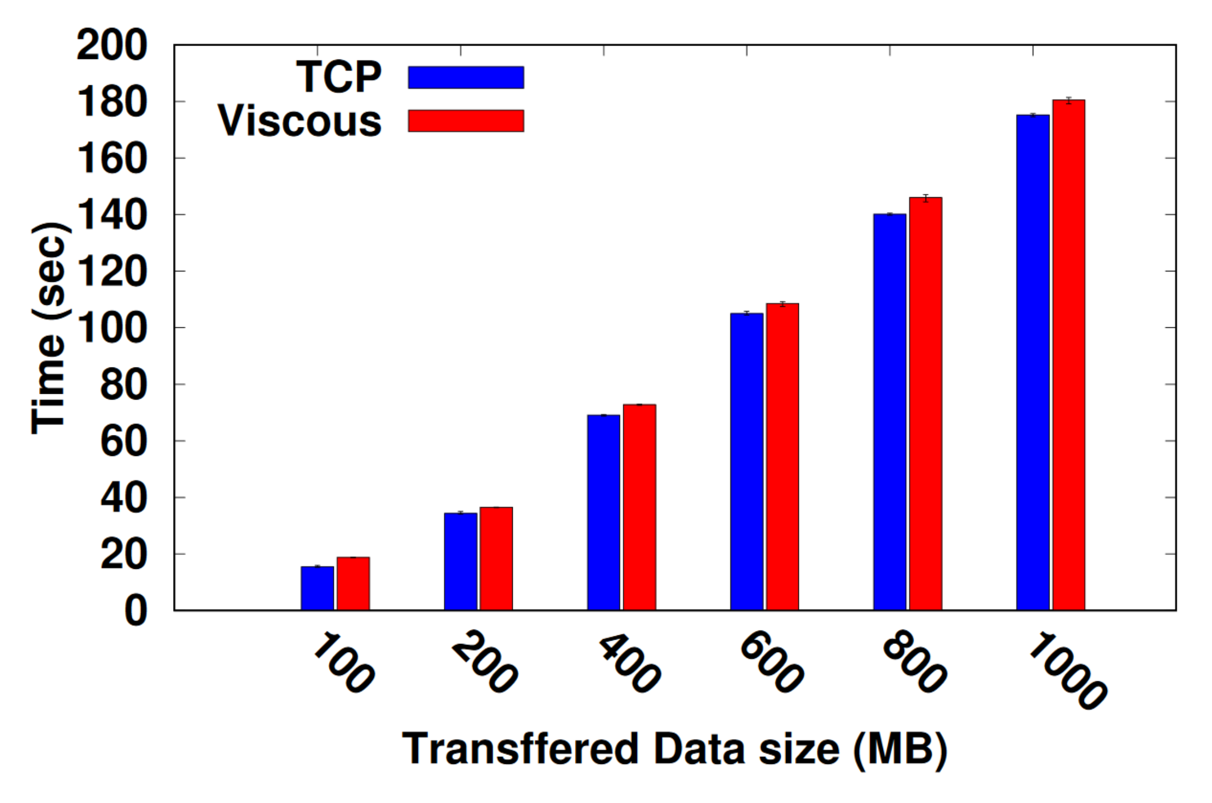
Experiment 2
Result: Time to Download Files
Viscous performs as good as TCP

Slide 48
Conclusions
Existing transport protocols lack one or more of the three important features-
Mobility support
Capacity utilization for multihome devices
Support of short-lived flows over the network
We developed the first baseline of the protocol Viscous
Supports modular application programmability
Combines best from Google’s QUIC and MPTCP protocols
Includes feature for decoupling flow-control and congestion control

Slide 49



Complex Networks Research Group (CNeRG),
Department of Computer Science and Engineering,
IIT Kharagpur
INDIA 721302
http://www.cnergres.iitkgp.ac.in/
Website
Source
https://abhimp.github.io/Viscous/
http://tinyurl.com/viscous-source

Slide 50
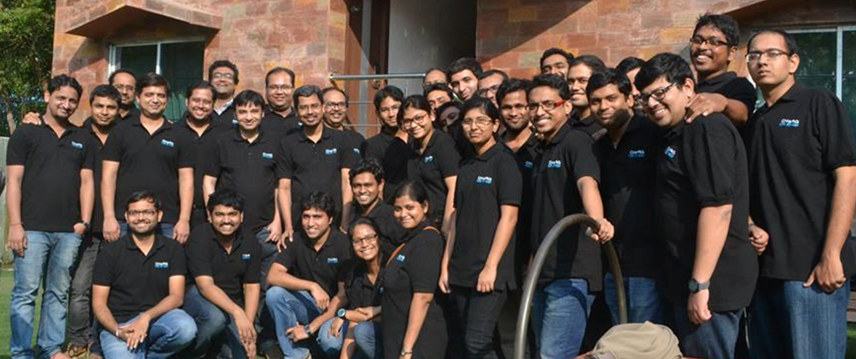
Complex Networks Research Group (CNeRG),
Department of Computer Science and Engineering,
IIT Kharagpur
INDIA 721302
http://www.cnergres.iitkgp.ac.in/

Slide 51
Links
Website
Source
https://abhimp.github.io/Viscous/
http://tinyurl.com/viscous-source

Slide 52
Website
Source
https://abhimp.github.io/Viscous/
http://tinyurl.com/viscous-source
Complex Networks Research Group (CNeRG),
Department of Computer Science and Engineering,
IIT Kharagpur
INDIA 721302
http://www.cnergres.iitkgp.ac.in/

